Slide 1

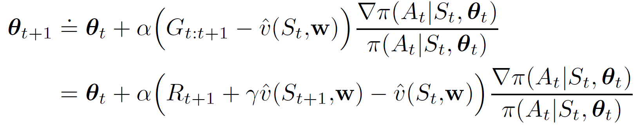

Recap: Actor-Critic Methods
One-step actor-critic
Let’s bootstrap this
Critic evaluates actions
Actor takes actions
Only need one step sampling from environment
Based on the current value model estimate, everything we have learnt so far applies (e.g., MC/TD)!
A source of bias due to bootstrapping!

Slide 2
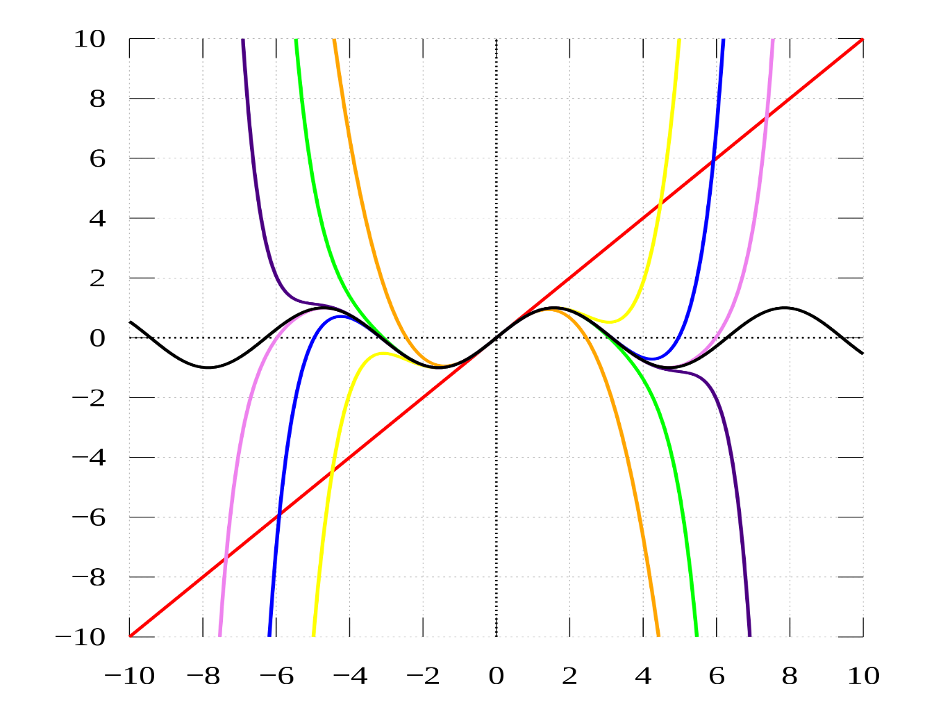
Approximation Methods
Hongning Wang
CS@UVA

Slide 3
Outline
Value function approximation
On-policy prediction with approximation
On-policy control with approximation
Off-policy learning with approximation

Slide 4
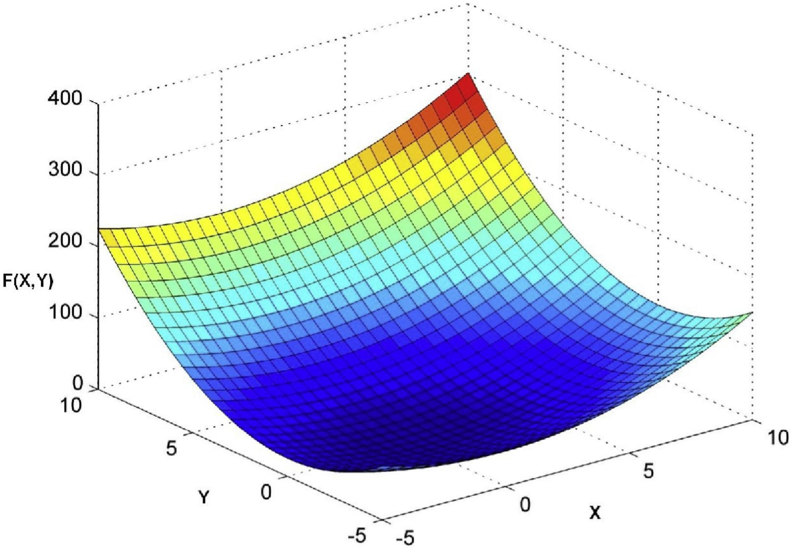
Tabular methods for RL
Enumerate and store all state(-action) values in a big table
  Recall MP2
Entire state space, or state-action space

Slide 5



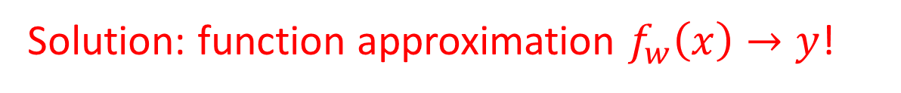
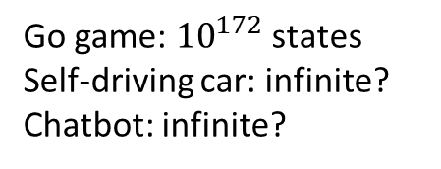
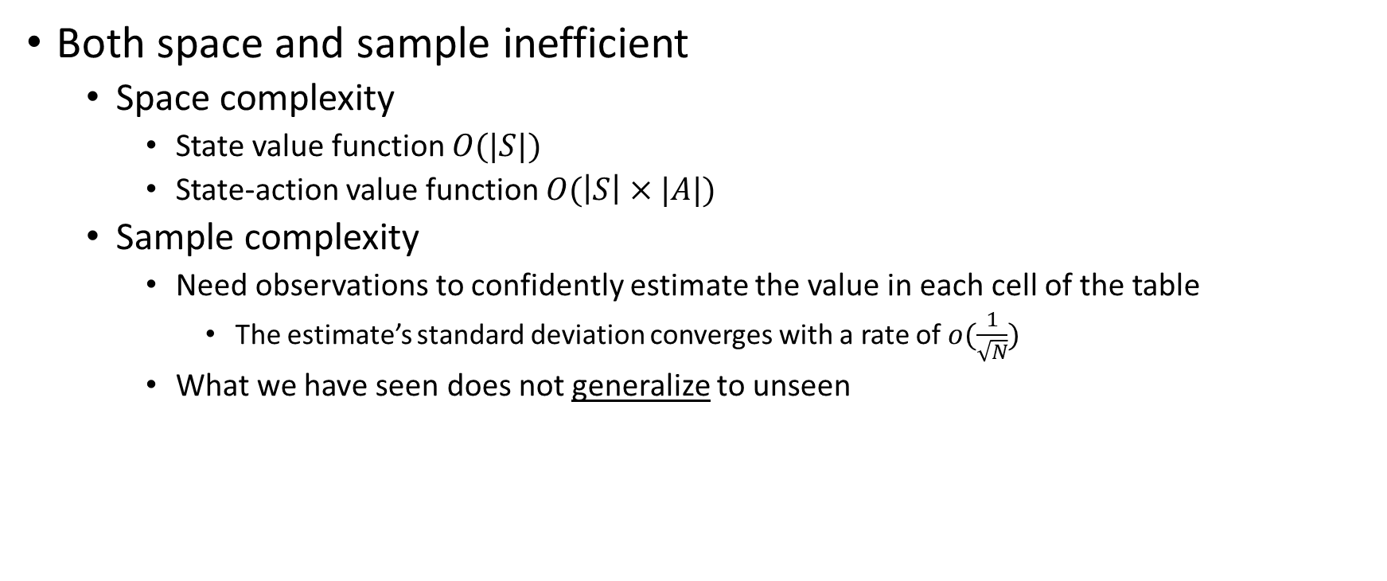
Tabular methods for RL
Chernoff-Hoeffding bound
Both space and sample inefficient
  Space complexity
    State value function $O(|S|)$
    State-action value function $O(\left|S\right|×|A|)$
  Sample complexity
    Need observations to confidently estimate the value in each cell of the table
      The estimate’s standard deviation converges with a rate of $o(\frac{1}{\sqrt{N}})$
    What we have seen does not generalize to unseen
Go game: ${10}^{172}$ states
Self-driving car: infinite?
Chatbot: infinite?
Obtained by interacting with the environment!!
Solution: function approximation $f_{w}\left(x\right)→y$!

Slide 6
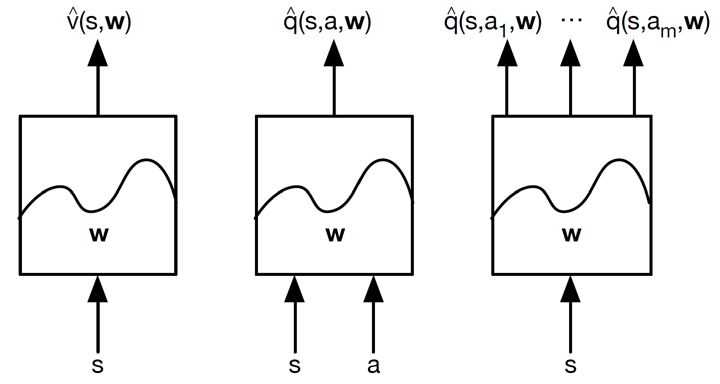
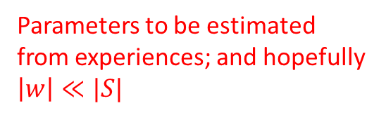
Function approximation for RL
Parameters to be estimated from experiences; and hopefully $\left|w\right|≪|S|$
Figure credit: David Silver, “Value Function Approximation”

Slide 7
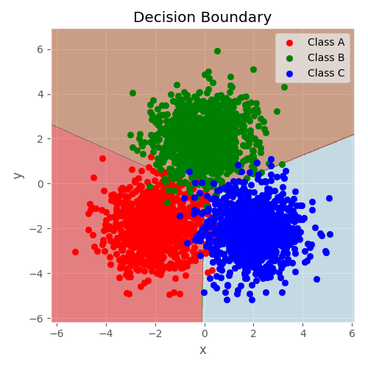
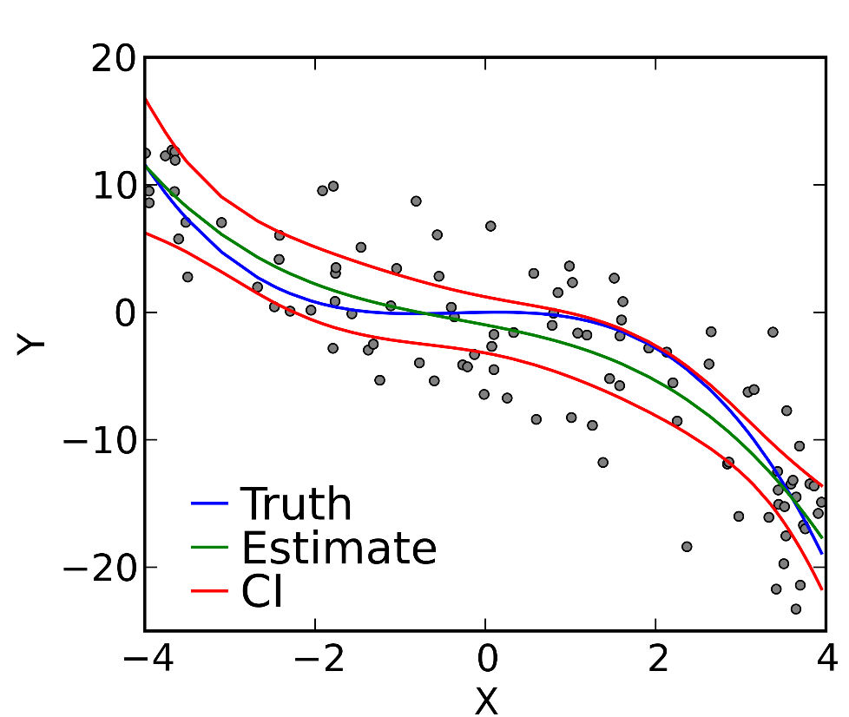

Supervised machine learning
Classification
  Discrete response
Regression
  Continuous response

Slide 8
Supervised machine learning
Fundamental assumptions
  Independent and identically distributed instances
    Empirical risk minimization
  Typically under a stationary distribution
Both are violated in an RL setting!

Slide 9
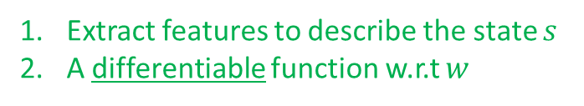
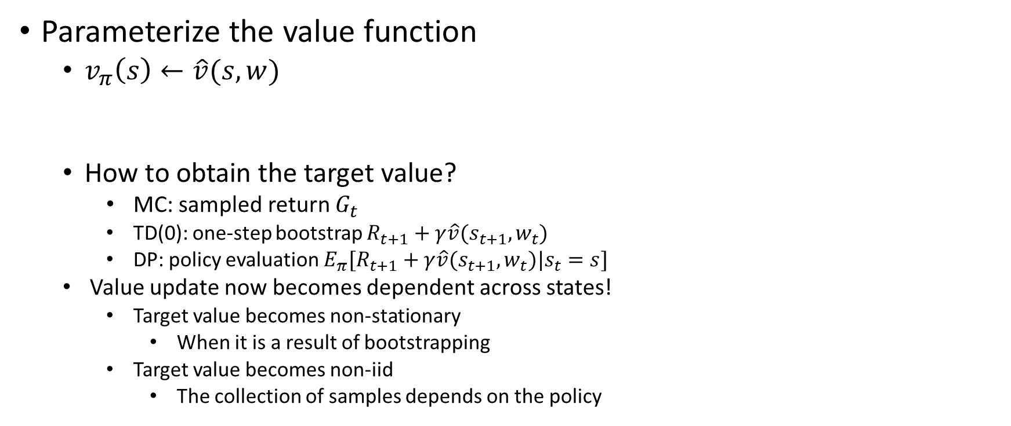
Value function approximation
Parameterize the value function
  $v_{π}\left(s\right)←\hat{v}(s,w)$
  How to obtain the target value?
    MC: sampled return $G_{t}$
      TD(0): one-step bootstrap $R_{t+1}+γ\hat{v}(s_{t+1},w_{t})$
      DP: policy evaluation $E_{π}[R_{t+1}+γ\hat{v}(s_{t+1},w_{t})|s_{t}=s]$
    Value update now becomes dependent across states!
      Target value becomes non-stationary
        When it is a result of bootstrapping
      Target value becomes non-iid
        The collection of samples depends on the policy
Extract features to describe the state $s$
A differentiable function w.r.t $w$
Target value for approximation
The same as we have done in tabular cases!

Slide 10




Value function approximation
Objective of approximation
  Minimize the difference between $v_{π}\left(s\right)$ and $\hat{v}(s,w)$ in ALL states
$$E_{u(s)}{\left[v_{π}\left(s\right)−\hat{v}\left(s,w\right)\right]}^{2}$$
Mostly for simplicity of analysis
State distribution
Goal of value function learning? Guide policy optimization
Mean square error is NOT necessarily the best objective for value function approximation, which leads to improved policy optimization.

Slide 11
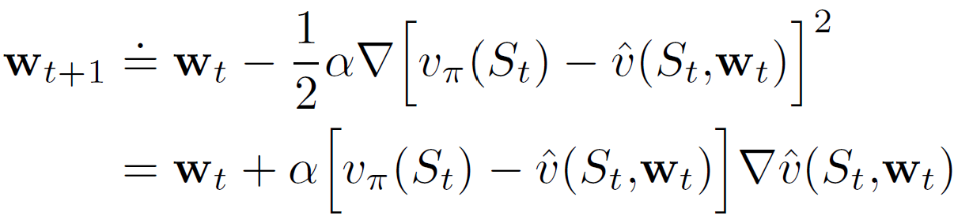
Incremental update
Update the approximation after every action taking
  Any online optimization method would work
    The objective function is not necessarily convex
    Stochastic gradient descent is typically the choice
Step size/learning rate
Gradient w.r.t. approximation
Can be estimated by any of policy prediction methods, e.g., DP, MC, TD
Approximation error

Slide 12
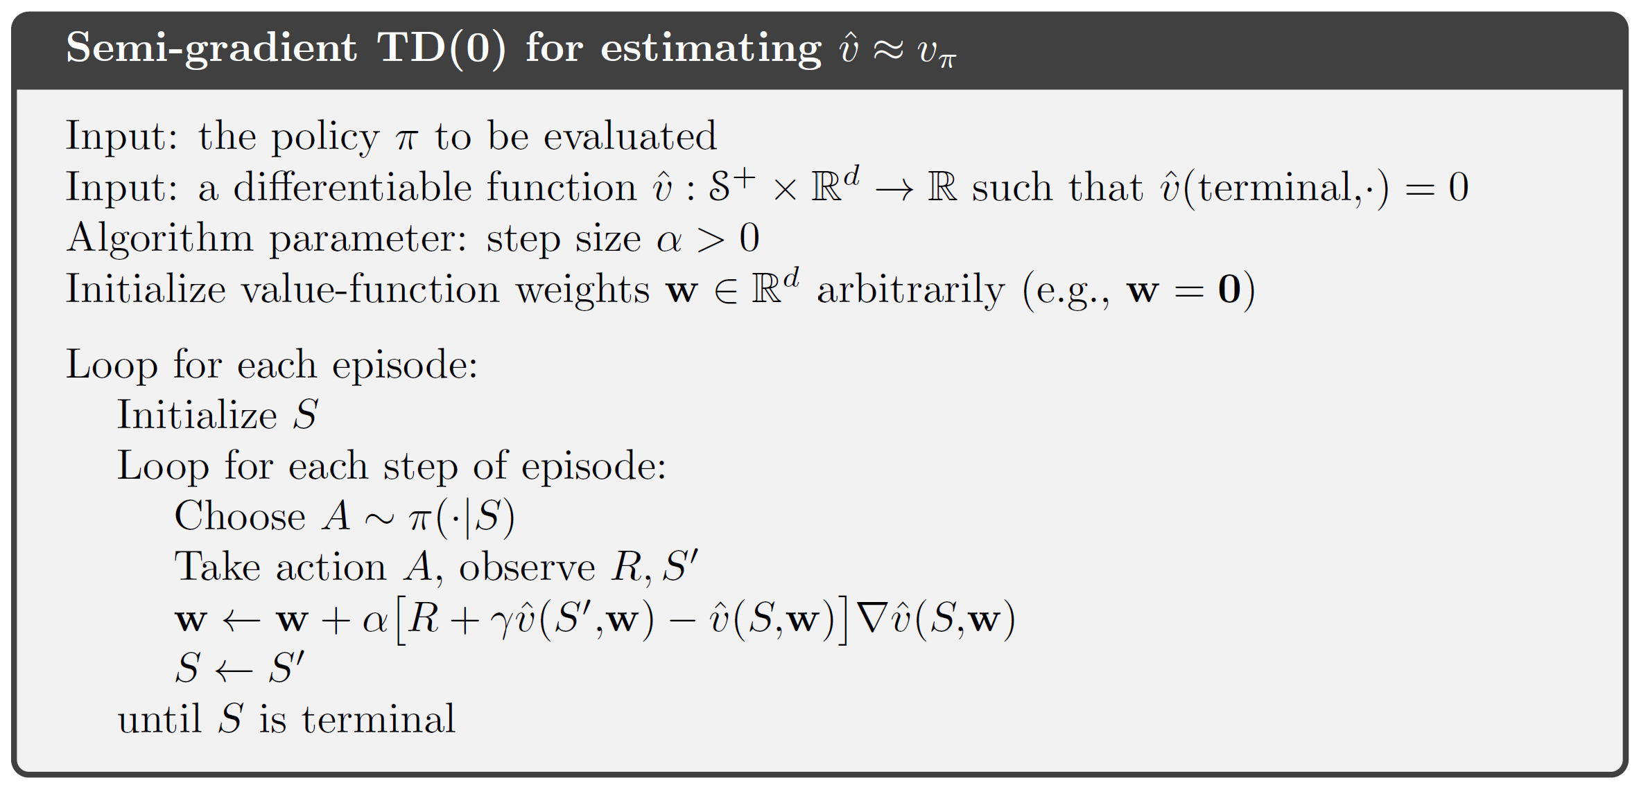
Incremental update
Because the target value is obtained by bootstrapping
A policy prediction problem
TD(0)

Slide 13
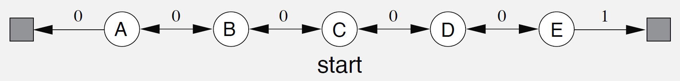
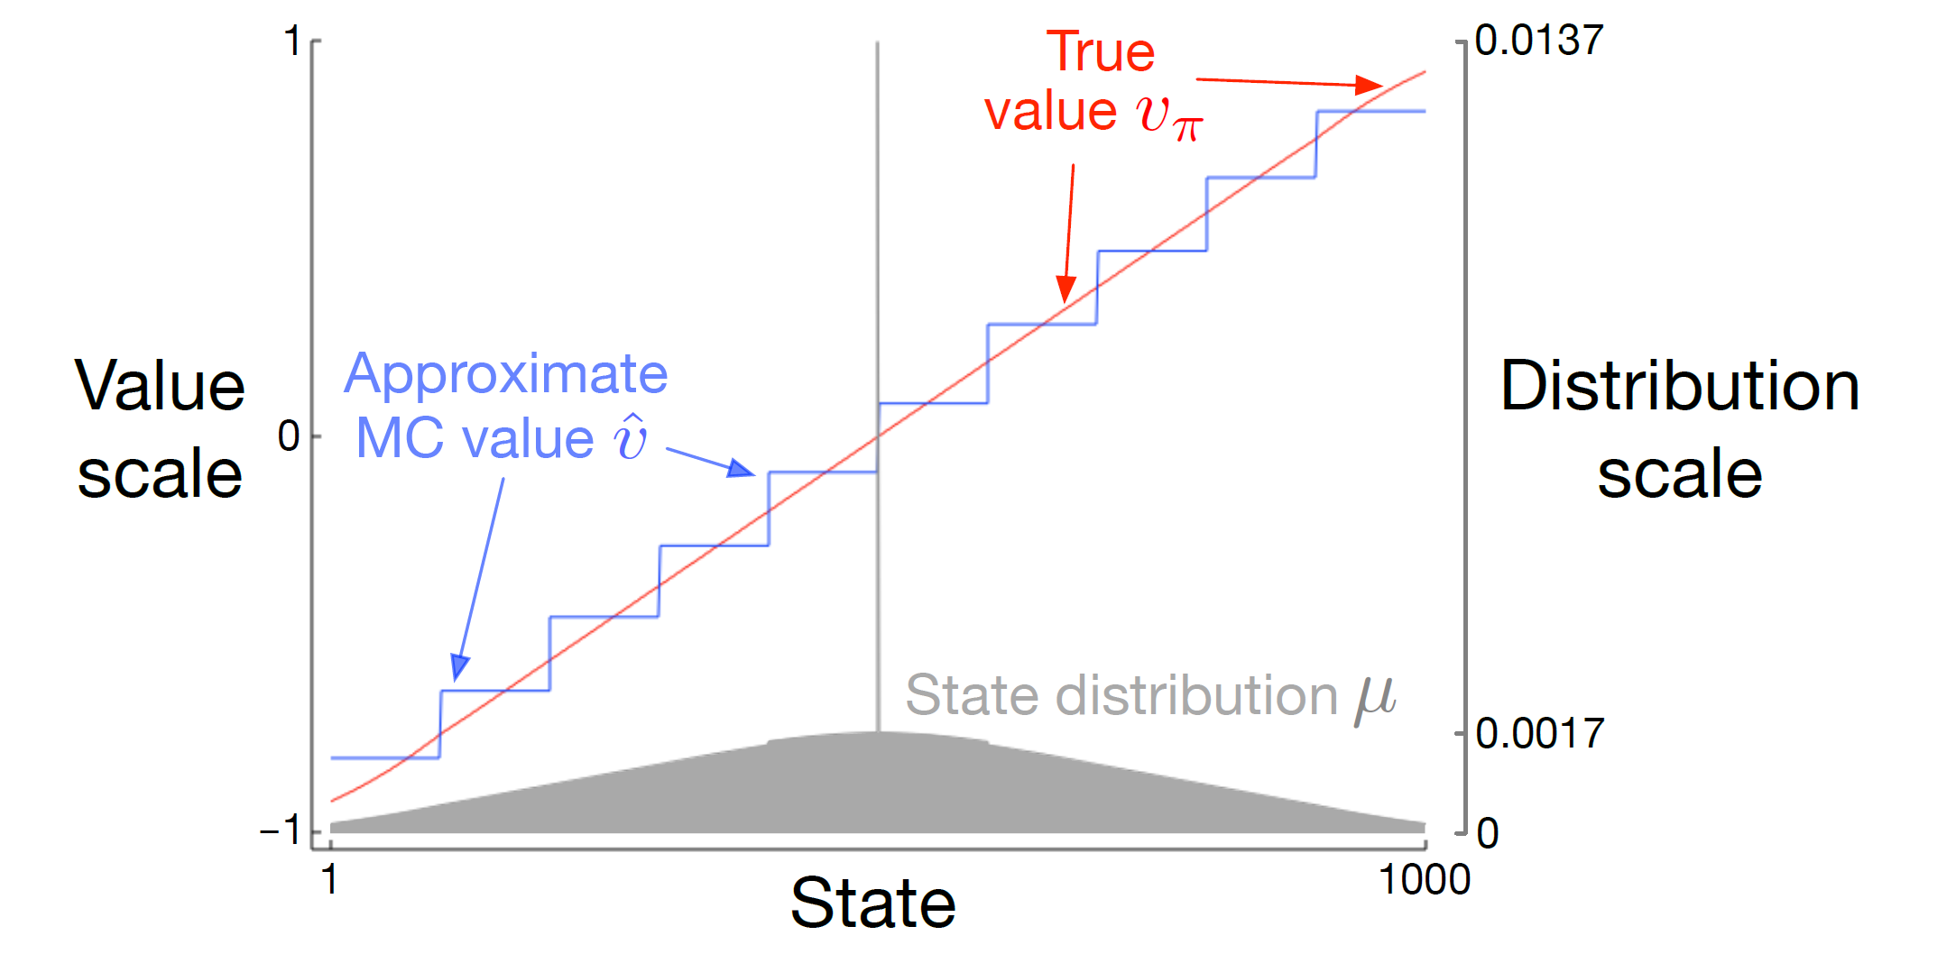
Incremental update
-1
Extend to 1000 states
State representation: every 100 states share one parameter

Slide 14
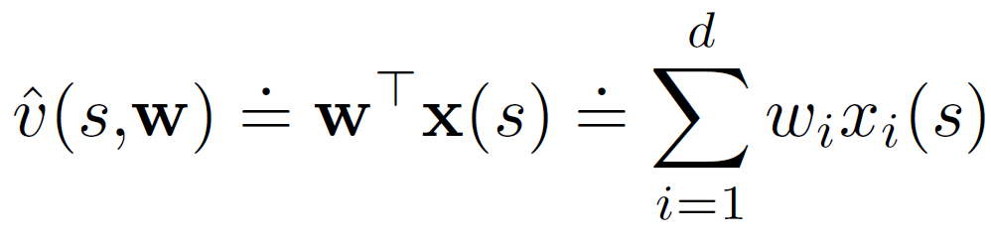
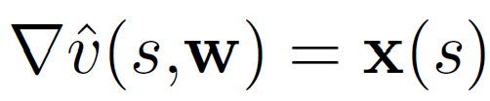
Linear models
One of the most well-studied approximation methods
  Guaranteed convergence under gradient descent
    Needs an unbiased gradient estimation, e.g., MC methods

Slide 15
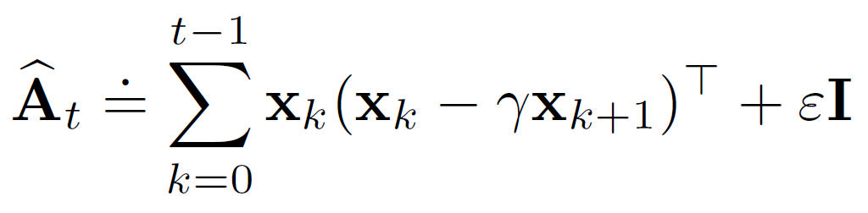
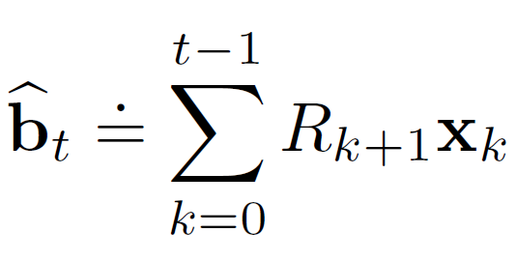
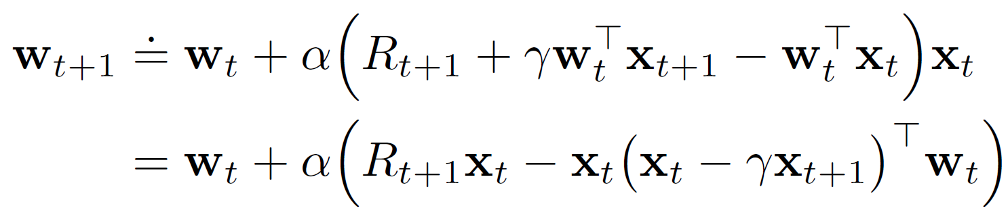

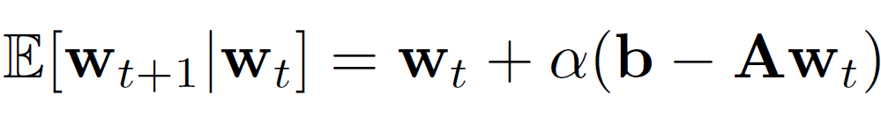

Linear models under semi-gradients
LSTD method
Under TD(0) semi-gradient
Is it invertible?
Yes, and the analysis is very similar to that proved in policy iteration
When the estimation converges
Equals to 0
By solving this system of linear equations
Known as the least square TD (LSTD) method

Slide 16
Recap: Bellman equation for value function
A closer look with a matrix form
  For any non-zero vector $x∈R^{|S|}$
$${\left\|\left(I−γP_{π}^{ss^{′}}\right)x\right\|}_{∞}={\left\|x−γP_{π}^{ss^{′}}x\right\|}_{∞}$$
$≥{\left\|x\right\|}_{∞}−γ{\left\|P_{π}^{ss^{′}}x\right\|}_{∞}$
$≥{\left\|x\right\|}_{∞}−γ{\left\|x\right\|}_{∞}>0$
$A$ is invertible if for any non-zero vector $x$, $Ax>0$

Slide 17
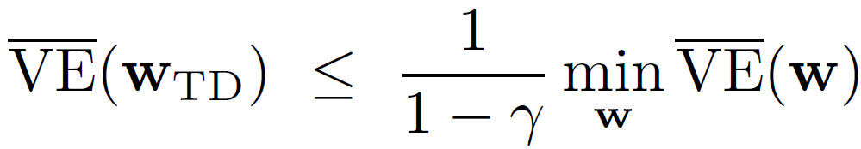
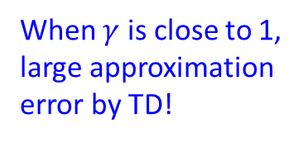
Linear models under semi-gradients
Under TD semi-gradient
Approximation error obtained by TD
Approximation error obtained by MC
Larger bias, faster convergence
When $γ$ is close to 1, large approximation error by TD!
Larger variance, slower convergence

Slide 18
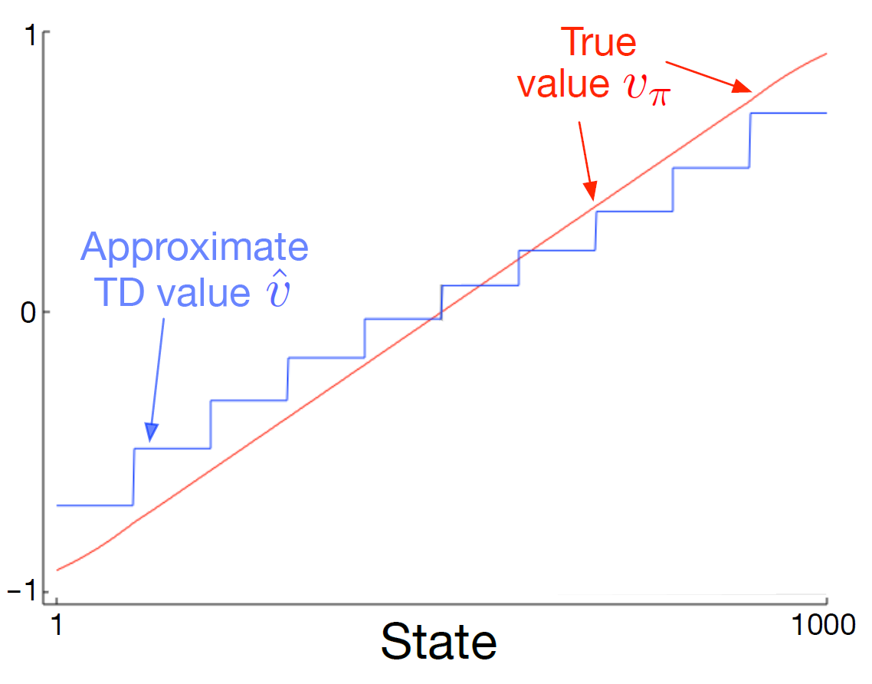
Incremental update
-1

Slide 19
Many other different types of approximations
Non-linear models
  Regression trees
  Neural networks, a.k.a, Deep RL
  Kernel methods
Almost all methods we have learned in machine learning apply here!
All aforementioned methods apply to action value function approximation!

Slide 20
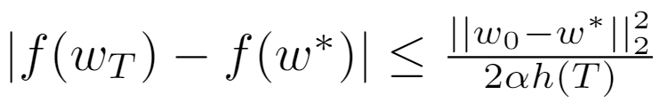


Batch update
Rate of convergence
Online methods typically converge slowly
  SGD’s convergence rate is $O(1/\sqrt{T})$
  Gradient descent’s rate is $O(1/T)$
  Slower convergence means more samples are needed to attain the same level of estimation accuracy
Solution: from online update to batch update
Trade-off: more immediate update vs., more accurate update

Slide 21
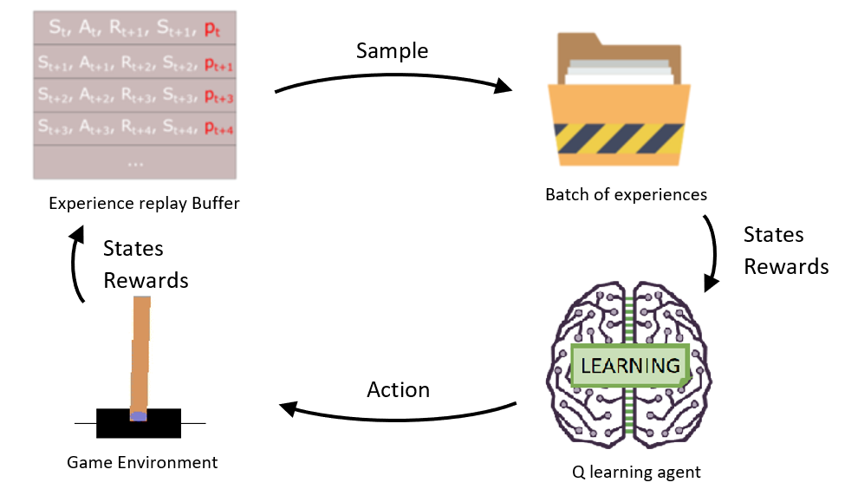

Experience replay
Accumulate experiences from past interactions
  At each round $t$, sample a set of experiences from $D_{t}^{π}$
  Execute SGD on it for model update
$$D_{t}^{π}=\left\{\left(s_{0},v_{0}^{π}\right),\left(s_{1},v_{1}^{π}\right),…,\left(s_{t},v_{t}^{π}\right)\right\}$$
How to? Uniformly?
Prioritize by TD error (proportionally)
Figure credit: MC.AI

Slide 22
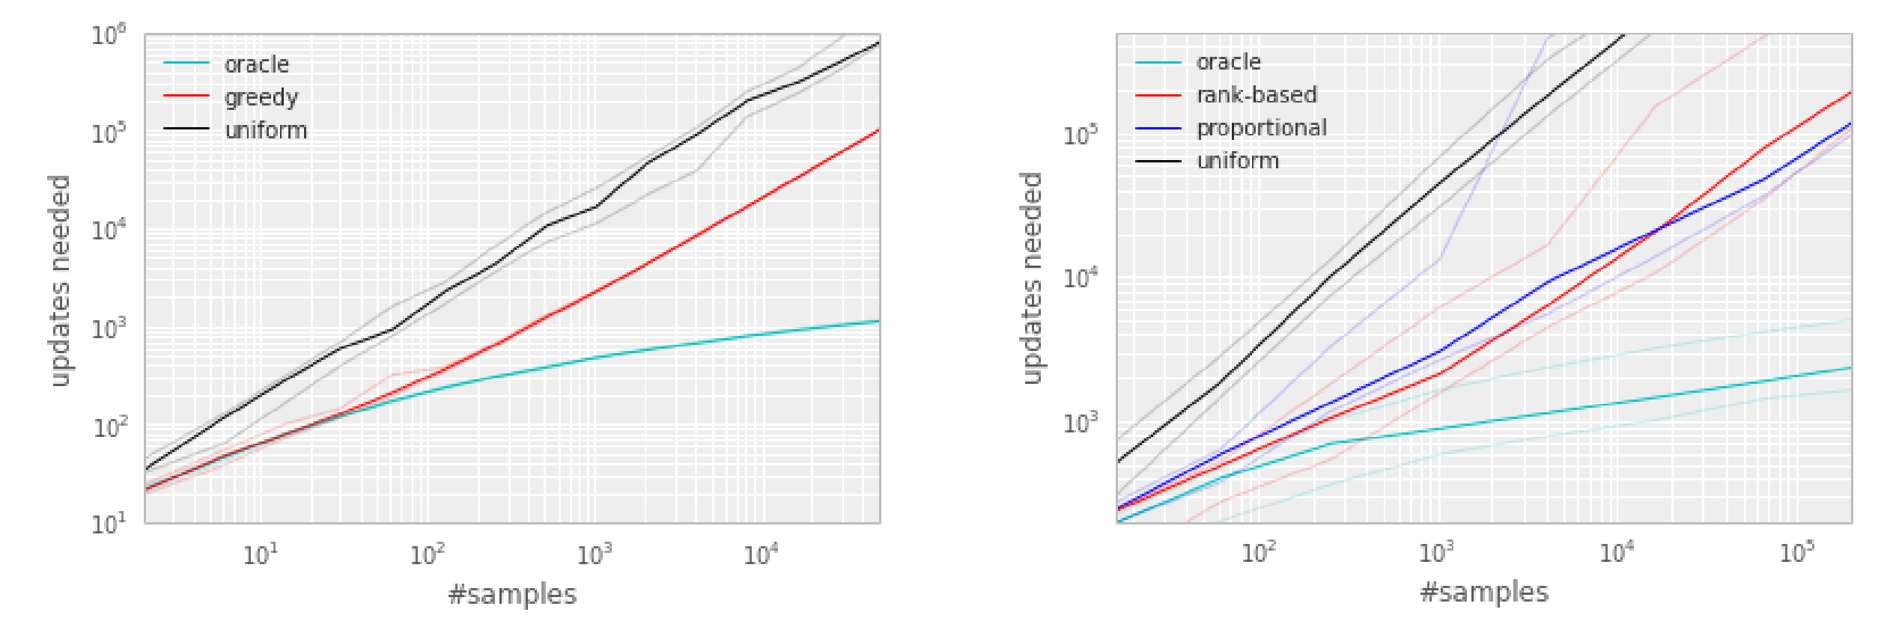
Prioritized experience replay
Q-learning with tables
Q-learning with linear approximation
Figure credit: Schaul et al., “Prioritized experience replay”, ICLR’2016

Slide 23
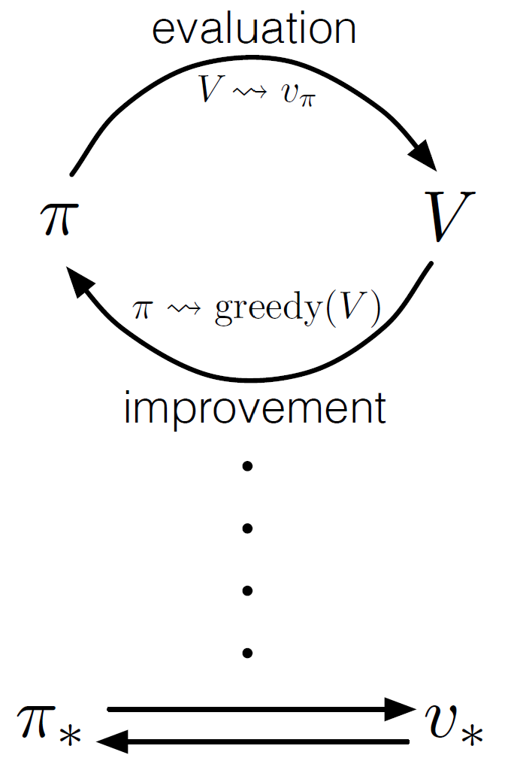
Control with value approximation
Under generalized policy iteration
Now we will apply the approximation methods to the action value function.
Policy evaluation is approximated
Target of approximation
Act according to the updated approximation
Might need longer time to converge to optimal policy; or even might not converge

Slide 24
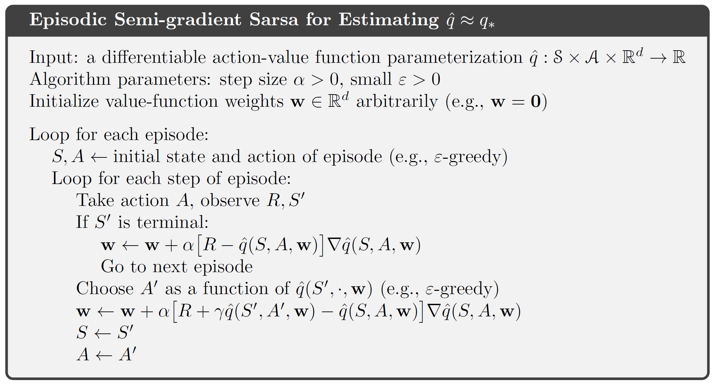
On-policy learning with approximation
We always require this
What’s the key difference from the prediction case?

Slide 25
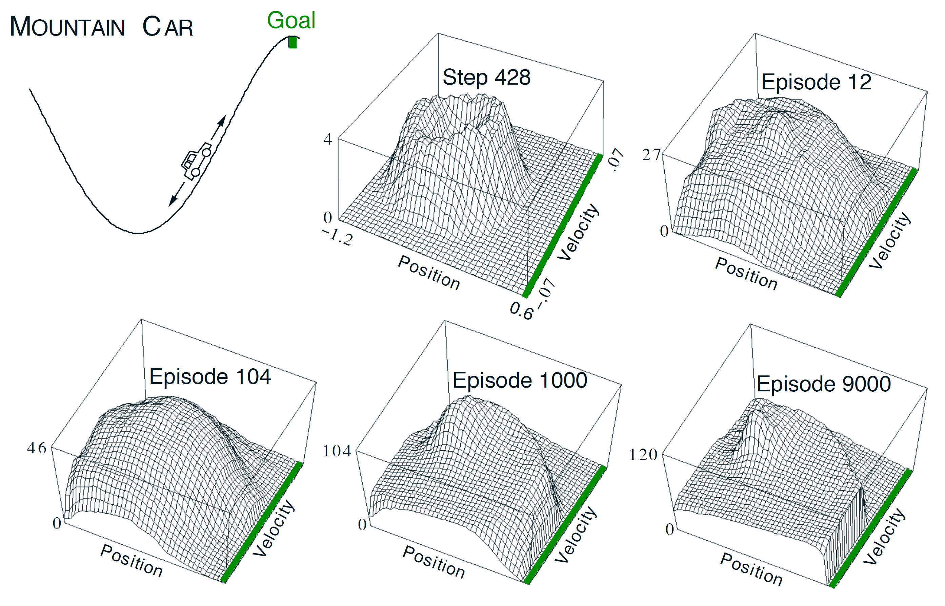

Sarsa with action value approximation
Initialize the value by zero, overly optimistic!
Three possible actions:
full throttle forward (+1)
full throttle reverse (-1)
zero throttle (0)
Reward is -1 on all time steps until reaching the goal
$$−\max_{a}{\hat{q}(s,a,w) }$$

Slide 26
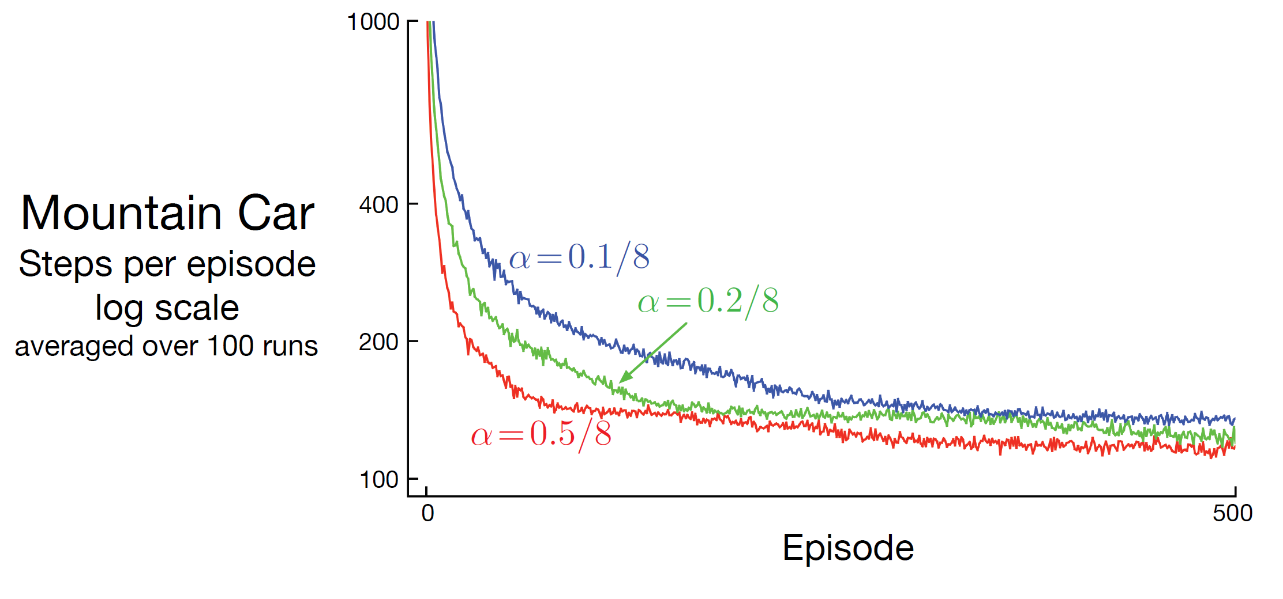
Sarsa with action value approximation
Because of the employed “grid-tilings” feature representation

Slide 27


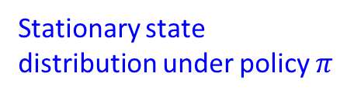
Off-policy learning with approximated function value
Now we have shifted target value and target distribution
$$∇E_{u(s)}{\left[v_{π}\left(s\right)−\hat{v}\left(s,w\right)\right]}^{2}$$
$$=2E_{u(s)}{\left[v_{π}\left(s\right)−\hat{v}\left(s,w\right)\right]∇\hat{v}\left(s,w\right)}^{}$$
Stationary state distribution under policy $π$
Target value under policy $π$
2
1
In off-policy learning, both of them come from behavior policy $b$!
2
can be addressed by importance sampling!

Slide 28
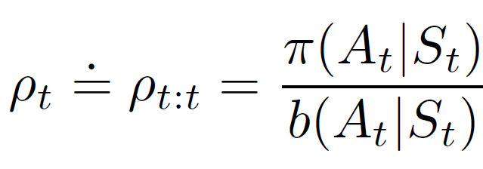
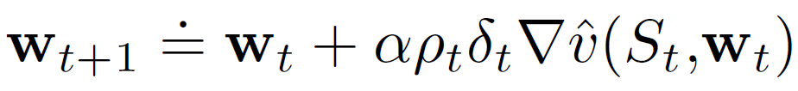
Target value correction
Importance sampling
  Importance weight
  Gradient correction
Naturally generalize to multi-step correction as in MC methods
The previous learnt off-policy methods, e.g., expected Sarsa and Treeback also apply for this purpose, as they directly provide us the target value.

Slide 29
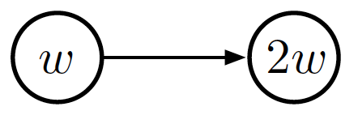




Challenges in off-policy control with approximation
Behavior policy is unaware of the quality of approximation
  A one dimensional case
$γ=0.99$, reward=0
Initialize $ω$=10, and set step size $α$=0.1
TD(0) error = 0 + 0.99*2*10 – 10 = 9.8
Update $ω$ by semi-gradient TD(0): $ω$ = $ω$ + $α×$TD(0)$×∇ω$ = 10 + 0.1*9.8*1=10.98
TD(0) error = 0 + 0.99*2*10.98 – 10.98 = 10.76
Update $ω$ by semi-gradient TD(0): $ω$ = $ω$ + $α×$TD(0)$×∇ω$ = 10.98 + 0.1*10.76*1=12.06
…..

Slide 30
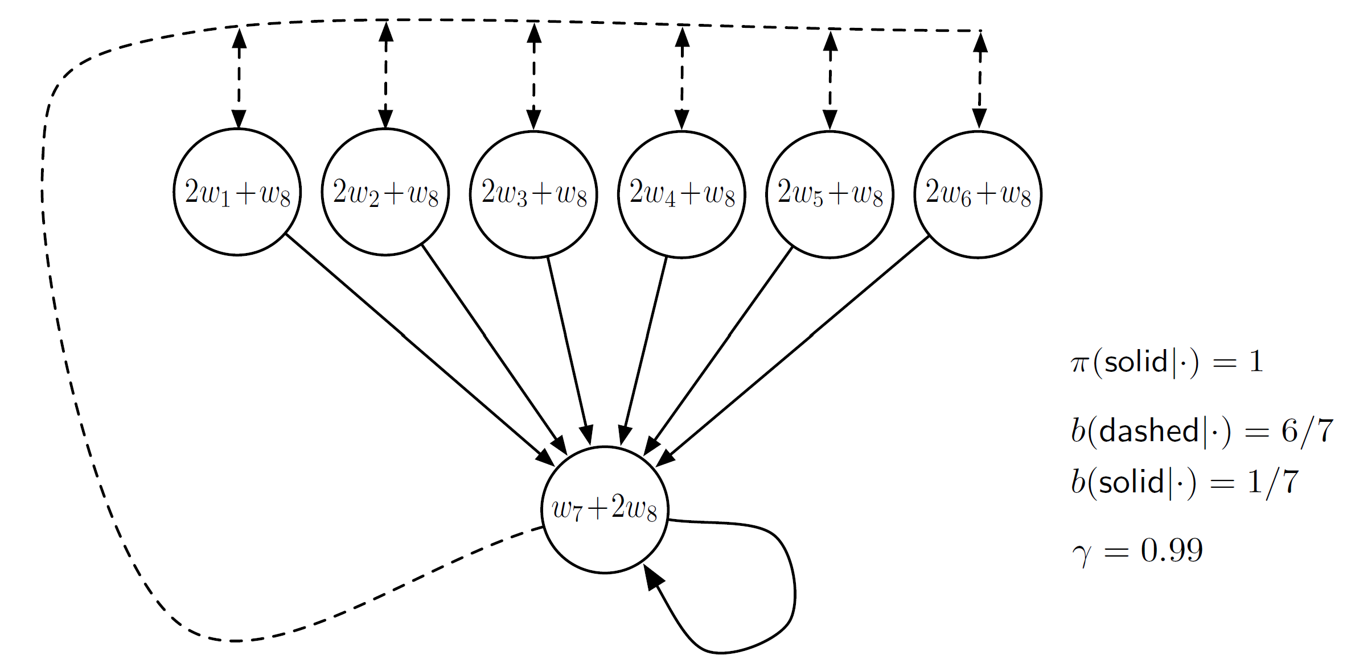
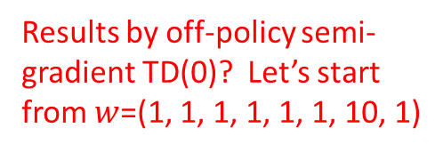
Baird’s counterexample
Results by off-policy semi-gradient TD(0)? Let’s start from $w$=(1, 1, 1, 1, 1, 1, 10, 1)
Reward is zero everywhere

Slide 31
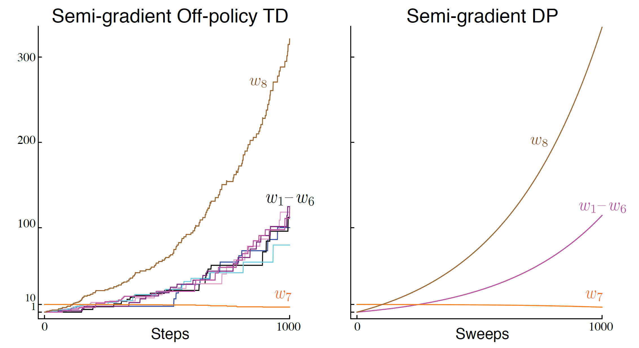
Baird’s counterexample
Deadly triad:
Function approximation
Bootstrapping
Off-policy learning

Slide 32
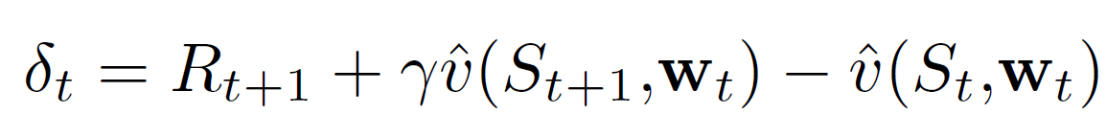
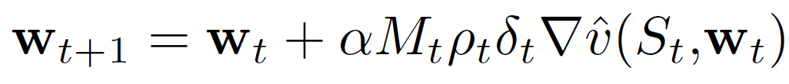


Emphatic-TD methods
Interpret discount factor as termination
  With probability $γ$ the transition continues; otherwise, it terminates and immediately restarts
  We can map each off-policy sequence as on-policy, by reweighing the states!
Reweigh the loss/gradient at current step
State emphasis
Source of large variance
Carry over the past transitions
Restart the transition

Slide 33
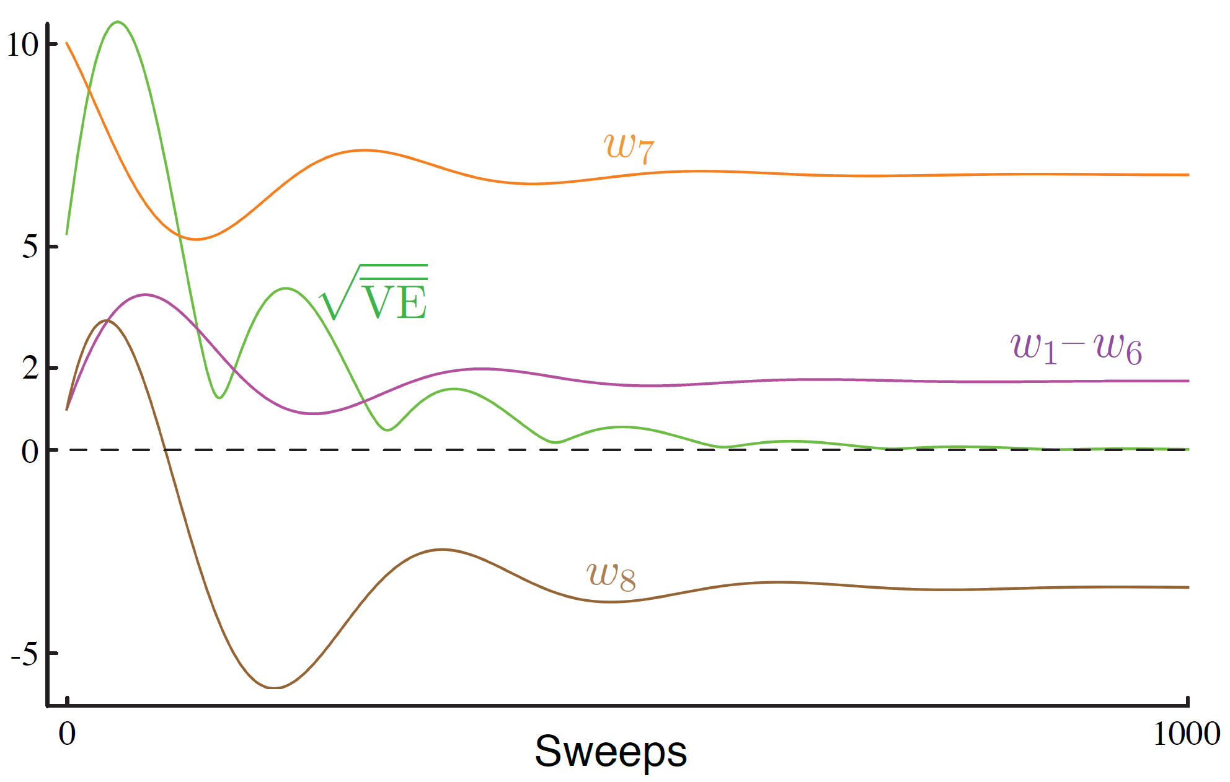
Emphatic-TD methods
Baird’s counterexample

Slide 34
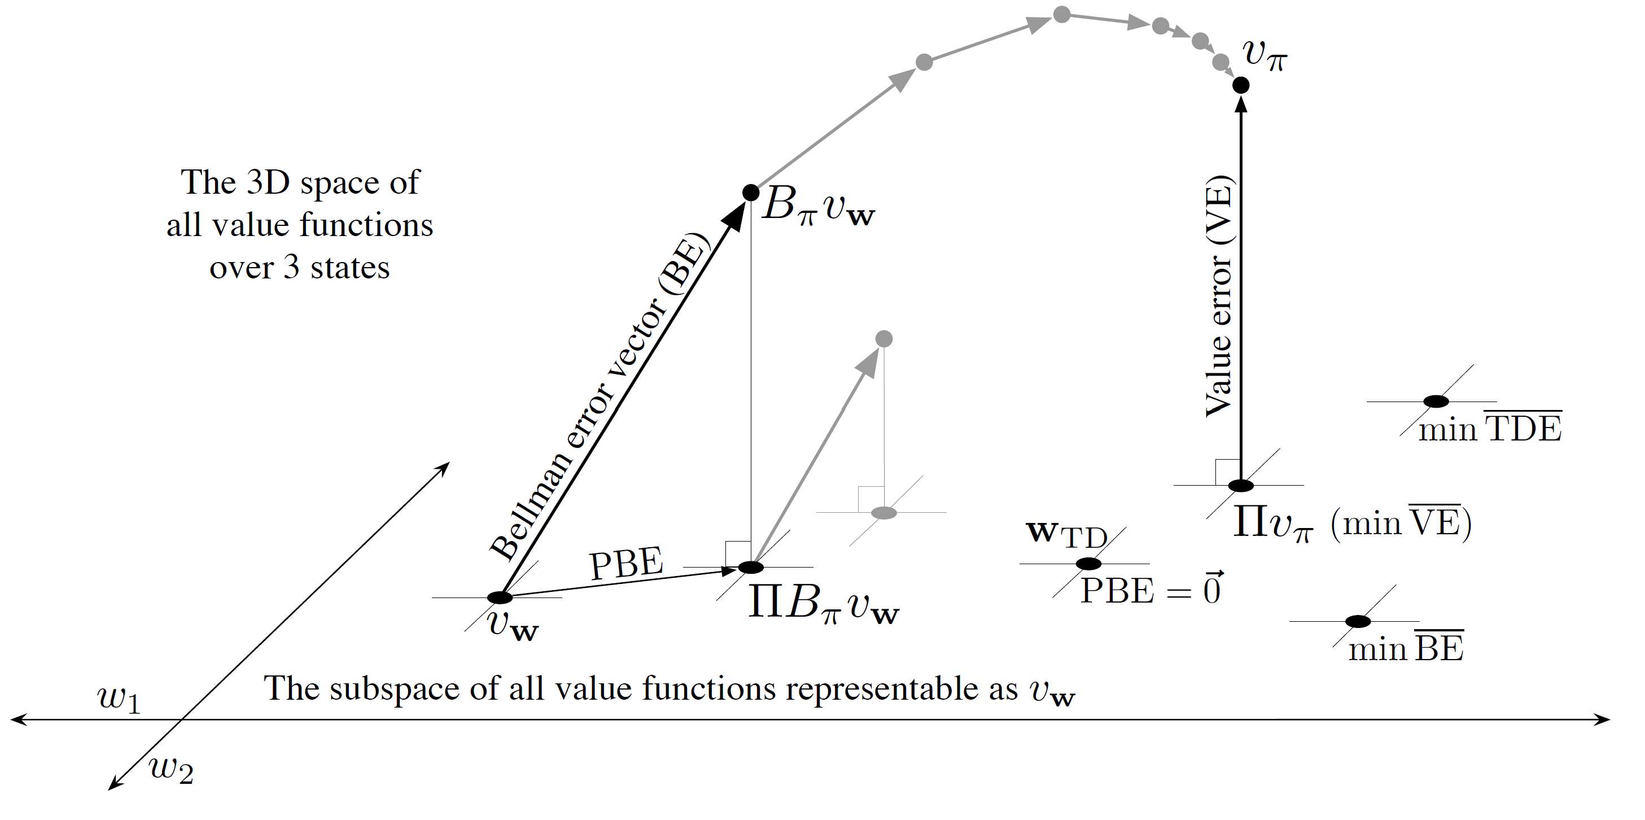

Linear value-function geometry
What is a better objective for off-policy learning?
Value error: $|\left|v_{w}−v_{π}\right||_{μ\left(s\right)}^{2}$
Projection operator
Bellman error: $|\left|E_{π}\left[R_{t+1}+γv_{w}\left(S_{t+1}\right)−v_{w}(S_{t})|S_{t}=s, A_{t}∼π\right]\right||_{μ\left(s\right)}^{2}$
Expectation of TD error!

Slide 35
Takeaways
Function approximation generalizes value estimation across states
On-policy prediction and control are typically performed as SGD + tabular methods based value estimation
Off-policy with value approximation is much more challenging

Slide 36
Suggested readings
Chapter 9: On-policy Prediction with Approximation
Chapter 10: On-policy Control with Approximation
Chapter 11: Off-policy Methods with Approximation

